Slide 1

Next word predictor
Submitted by-
Name: Anjali
University Roll No.: 2019532
Under the mentorship of -
Dr. guru prasad

Slide 2
INTRODUCTION
Natural Language Processing (NLP) is a field that aims to enable machines to understand and generate human language. One of the important task in NLP is Next Word Prediction (NWP), which is used in various real-world applications such as word sense disambiguation and text recognition. NWP aims to predict the next word in a sentence given a sequence of previous words. It is challenging because it requires understanding the context and meaning of the previous words. There are various techniques that has been widely studied over the years to achieve this task. They use a variety of approaches such as probability or neural networks to predict the next word in a sentence or text. Each of these techniques and models have their own strengths and weaknesses and can be combined to improve the performance of next word prediction.

Slide 3
Following are some of the common techniques used for next word prediction:
n-gram models
neural network-based models
statistical language models.
Neural network-based models use neural networks such as LSTMs to learn the relationship between input words and the next word. They can handle large amounts of data and learn complex relationships. Here we are creating a model for next word prediction by utilizing LSTM networks. NWP is important for various applications such as text-based interfaces, natural language generation systems, machine translation, and speech recognition.
PROBLEM STATEMENT: The main aim of this project is to predict the next word for the given sequences of words input by the user.

Slide 4
mETHODOLOGY
The methodology used here is to train a language model using a text file as our dataset and then predict the next word in a given input phrase. The model is trained using the Keras library in Python, which is a high-level neural networks API. To use LSTM for next word prediction, a dataset is first pre-processed and tokenized, and then the model is trained on this dataset. The LSTM model is trained to predict the next word. Once the model is trained, it can be used for prediction of the next word in a sentence given a new sequence of previous words.

Slide 5
Data pre-processing is an important step in creating our model. It involves cleaning and preparing the data to feed into the model. Libraries such as pandas and numpy are commonly used for data pre-processing. These libraries provide various functions to load, manipulate, and clean data.
The libraries used in our model are:
‘Keras’ - It is a powerful open-source library for building and training deep learning models. It is written in Python and is designed for fast experimentation and allows for easy and modular building of models.
‘NumPy’ – It is another library for the Python programming language that adds support for large, multi-dimensional arrays and matrices, along with a large collection of high-level mathematical functions to operate on these arrays. It is a fundamental package for scientific computing with Python.

Slide 6
The model is created using the Sequential class from Keras library, using an Embedding layer to represent words, an LSTM (Long Short-Term Memory) layer to handle sequential data and a Dense layer to connect all the neurons in the previous layer to the neurons in the current layer.
The first step is to open the text file and read its contents using the 'open' function in python and then tokenize the text using Tokenizer class from the Keras library's 'preprocessing.text' module.
The next step is to prepare the input and output data for training the model. The input data (X) is a list of n_words-length sequences of encoded text, and the output data (y) is the next word in the sequence for each input sequence.
Both X and y are then converted to arrays using numpy.
The model is then compiled and trained for 100 epochs.

Slide 7
RESULT AND DISCUSSIONS
This project makes use of different modules and libraries of Python to aid in its functionality. The embedding, LSTM and dense classes are used to build the neural network model. Additionally, the numpy library is utilized for numerical operations creating arrays and matrices. The proposed model uses the Long Short-Term Memory (LSTM) method for next word prediction. This takes in a text file and the number of words to be used as input for the model. The model is trained using the input and output sequences. It takes in the trained model that tokenizes the input text and converts it into numerical values. The last word of the input sequence are used as input for the model, and the next word is predicted using the model.

Slide 8
The model is created using the programming language which is Python. It is a popular, high-level programming language known for its clear syntax, dynamic semantics, and support for object-oriented programming. The performance of a next word predictor can be evaluated by its accuracy in predicting the next word, and this accuracy can be improved through the usage of large training datasets and more sophisticated learning methods.

Slide 9
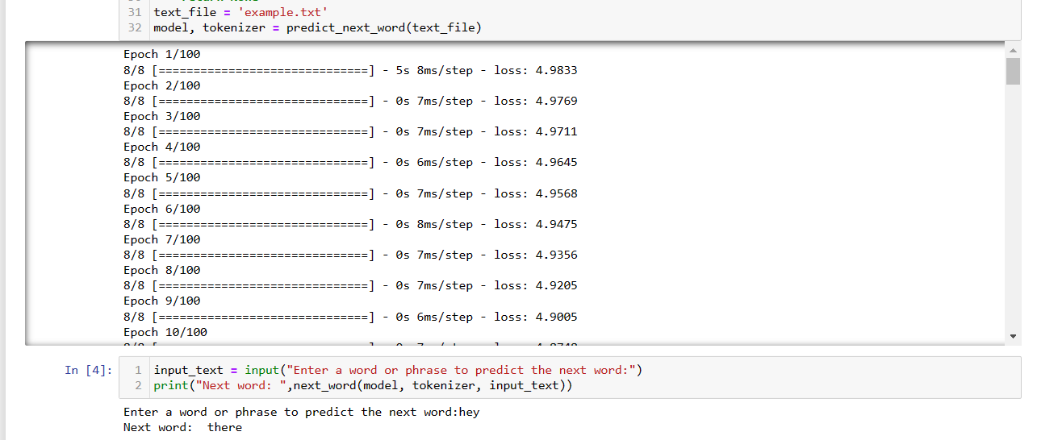
A simple demonstration of the project is shown. Here we can see that how the basic implementation of the project is done. The output that we got on implementing the code:

Slide 10
CONCLUSION
Next word prediction is a technique utilized in natural language processing that aims to predict the most likely word to follow a given sequence of words. This technology has a wide range of potential uses, such as in text completion, language translation, and speech recognition. We have created a model which take the input from the user and then predict the next word after processing the dataset which we have taken as a text file in our model. The limitations of the proposed model have been identified as the number of input words is taken into account and the next word is outputted. However, the accuracy of the prediction is dependent on the size of the dataset.

Slide 11
FUTURE WORK
The following areas of improvement will be focused on in future in order to enhance the capabilities of the next word prediction model:
increase in accuracy through the investigation of new techniques and methods.
expansion of the training dataset for the model to learn more patterns and improve performance.
testing on various types of text.
The capabilities of the next word prediction model will be enhanced and made more accurate in predicting the next word in a sentence, ultimately providing a better user experience, is aimed to be achieved.

Slide 12
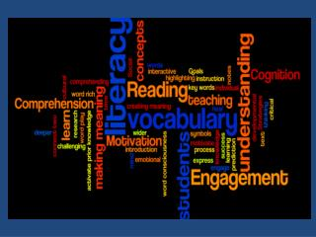
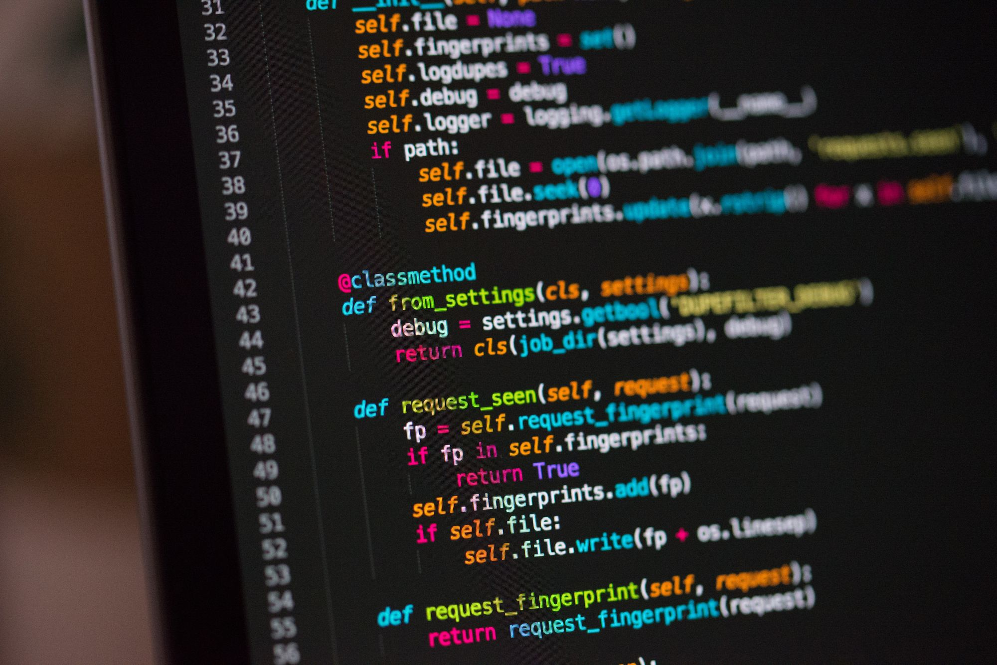


THANK YOU

